Slide 1
QoS

Slide 2
QoS
QoS is the set of techniques to manage network resources.
http://www.cisco.com/c/en/us/products/ios-nx-os-software/quality-of-service-qos/index.html
Quality of Service (QoS) for networks is an industry-wide set of standards and mechanisms for ensuring high-quality performance for critical applications
https://technet.microsoft.com/en-us/library/cc757120(v=ws.10).aspx
is a set of technologies that work on a network to guarantee its ability to dependably run high-priority applications and traffic under limited network capacity
https://www.paloaltonetworks.com/documentation/glossary/what-is-quality-of-service-qos
QoS (Quality of Service) refers to a broad set of networking technologies and techniques designed to guarantee predicable levels of network performance
https://www.lifewire.com/definition-of-qos-817890

Slide 3
Quality of Service
Aim – to provide quality of service matched to applications
Parameters –
There are 4 parameters of a flow that explains the kind of QoS an application needs
Reliability
Delay
Jitter
Bandwidth

Slide 4
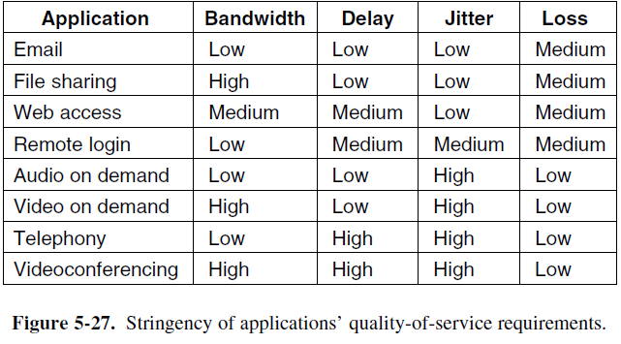
Application Requirements

Slide 5
Traffic Shaping Techniques
2 variations
Original
Byte Counting

Slide 6
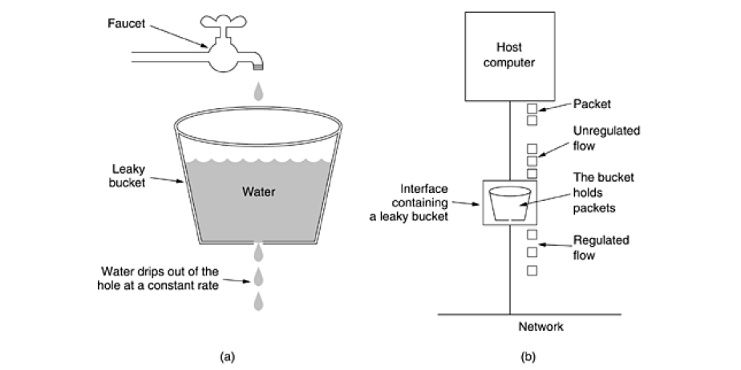
Leaky Bucket Algorithm

Slide 7
Token Bucket Algorithm
2 variations
Count token
Count bytes

Slide 8
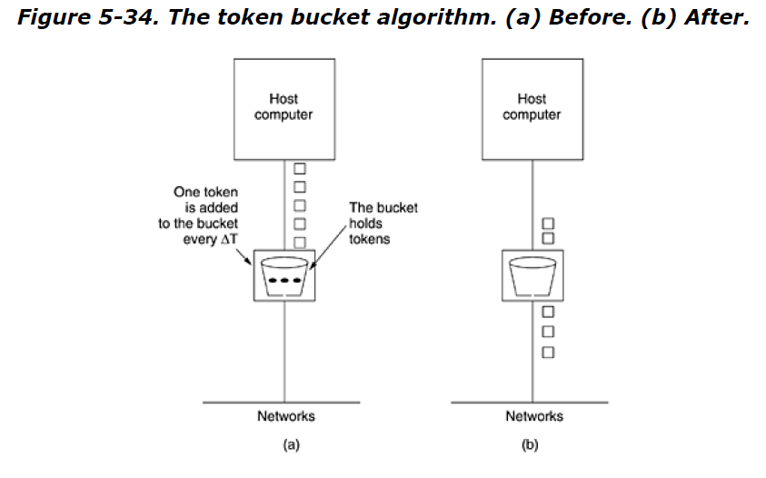
Token Bucket Algorithm

